Slide 1
ASP.NET MVC
Lesson 5 ViewModels

Slide 2
ViewModels
Passing data from Controller to View using a ViewModel (instead of ViewData)
Filter data using select
Update data
Reading relational data

Slide 3
Passing data from controller to view
Data | Method
Limited information a page title or one number (e.g. the number of products in shopping cart) | ViewData dictionary
1 datatype 1 rider or 1 team or 1 list of races or 1 list of tickets | ViewModel method (no need to create an extra class) (lessons 3 and 4)
Multiple datatypes a list of teams + a list van riders + teamId | ViewModel method (create an extra ViewModel class) (lesson 5)

Slide 4
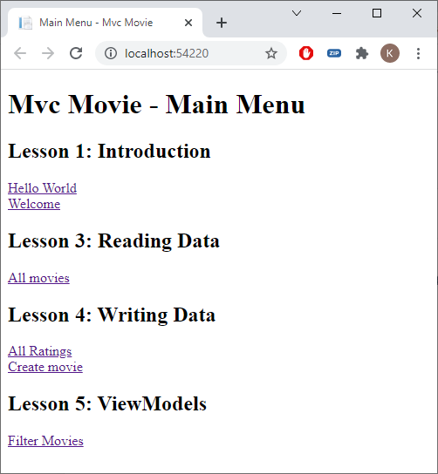

Home/Index.cshtml

Slide 5
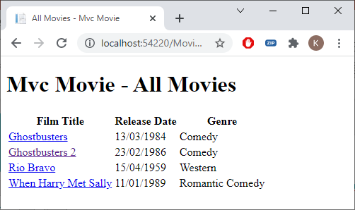
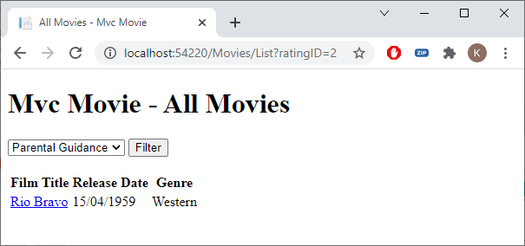
Filter Movies using a selectlist with Ratings

Slide 6
Moviescontroller.cs
public IActionResult List(int ratingID = 0)
{
if (ratingID != 0)
{
return View(_context.Movies.Where(m => m.RatingID == ratingID).OrderBy(m => m.Title).ToList());
}
else
{
return View(_context.Movies.OrderBy(m => m.Title).ToList());
}
}

Slide 7
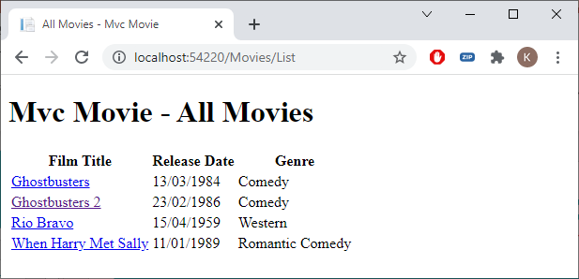
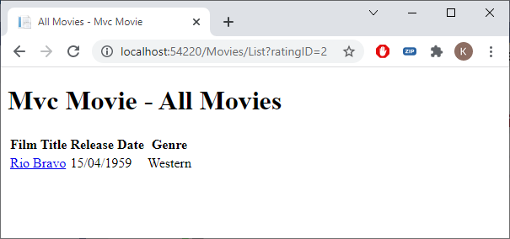
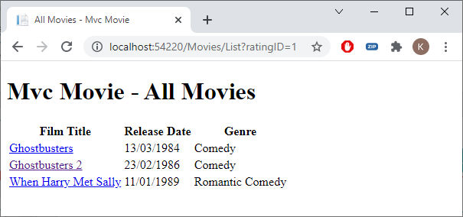
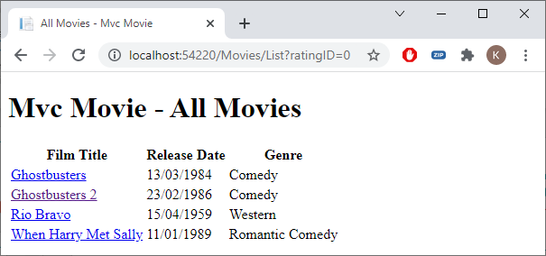
ratingid parameter

Slide 8
ViewModel
View Data:
Filtered movies
A SelectList containing all ratings
The ratingID of the selected rating
Passing all data from Controller to View with ViewModel class

Slide 9
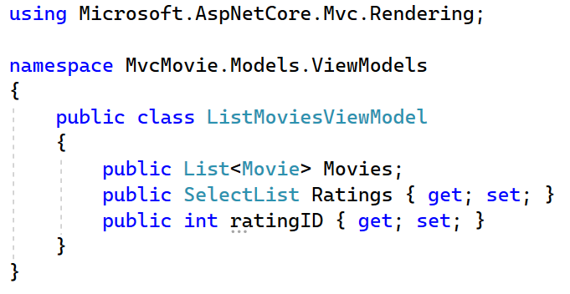
ViewModels
Models | Add New Folder | ViewModels
ViewModels | Add New Class | ListMoviesViewModel.cs

Slide 10
MoviesController.cs
public IActionResult List(int ratingID = 0)
{
var listMoviesVM = new ListMoviesViewModel();
if (ratingID != 0)
{
listMoviesVM.Movies = _context.Movies.Where(m => m.RatingID == ratingID).OrderBy(m => m.Title).ToList();
}
else
{
listMoviesVM.Movies = _context.Movies.OrderBy(m => m.Title).ToList();
}
listMoviesVM.Ratings =
new SelectList(_context.Ratings.OrderBy(r => r.Name),
"RatingID", "Name");
listMoviesVM.ratingID = ratingID;
return View(listMoviesVM);
}

Slide 11
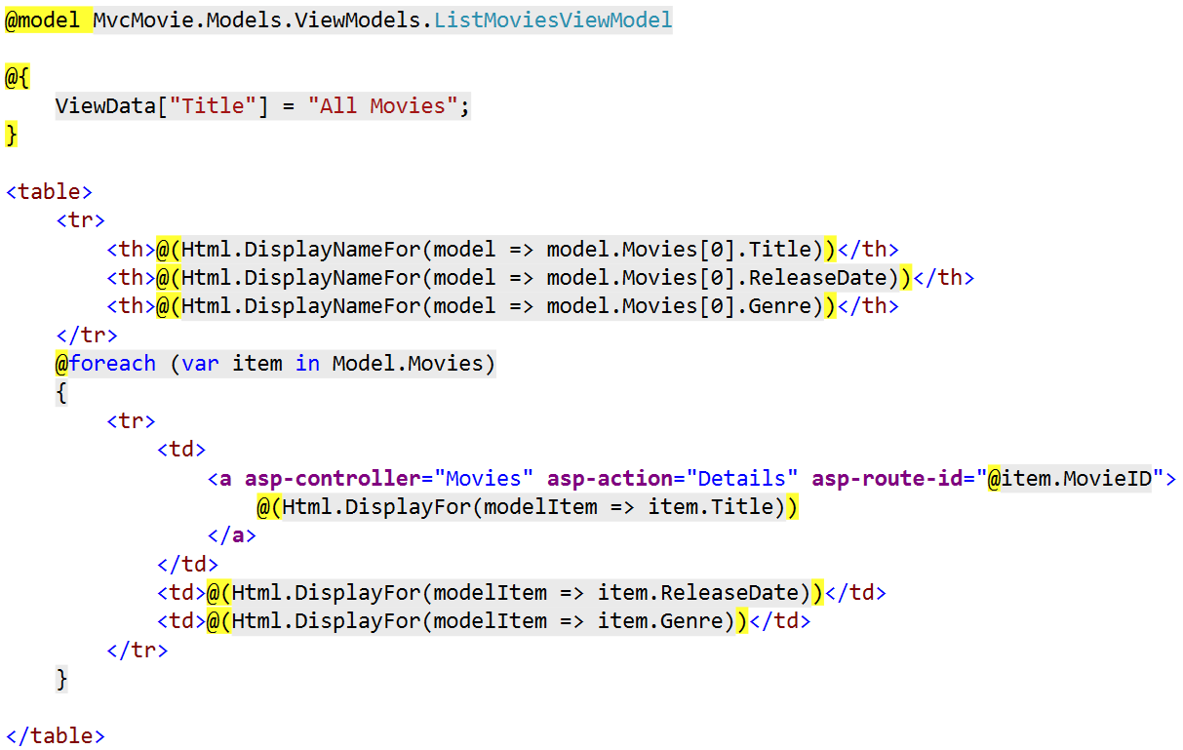
List.cshtml

Slide 12
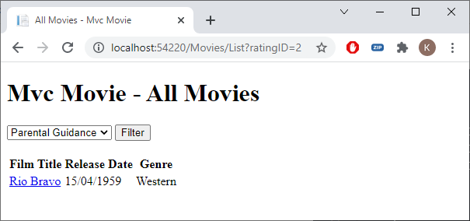
Select
@{
ViewData["Title"] = "All Movies";
}
<form asp-controller="Movies" asp-action="List" method="get">
<select asp-for="ratingID" asp-items="Model.Ratings">
<option value="0">-- Select a rating --</option>
</select>
<input type="submit" value="Filter" />
</form>
<br />
<table>

Slide 13
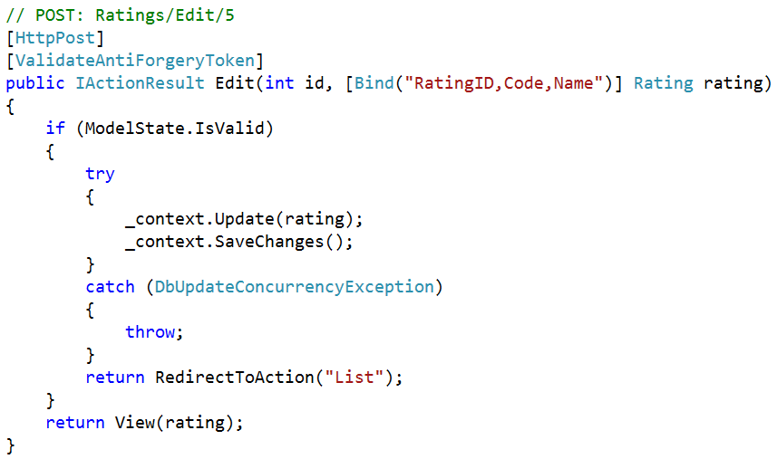
Update data (exercise)
How to update a selection of fields? For example, only update the Code, not the Name
Generated SQL statement will contain all columns

Slide 14
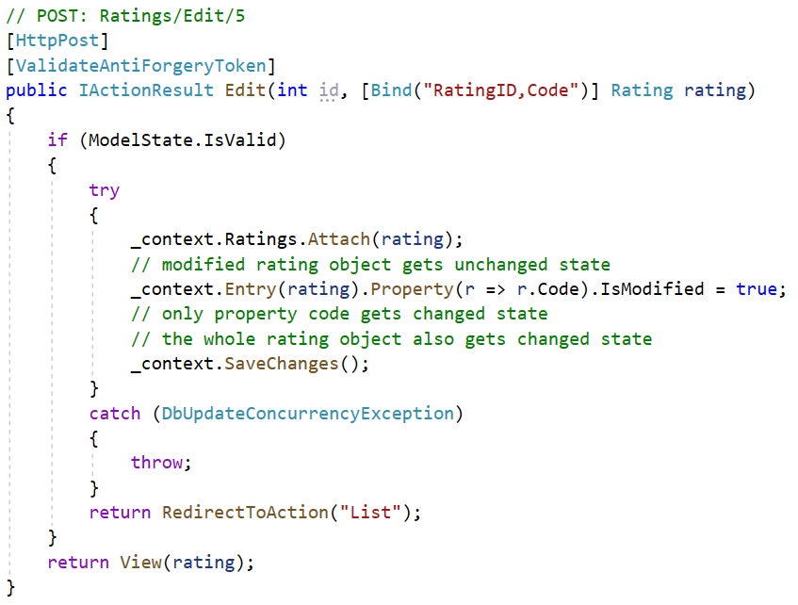
Attach
Generated SQL statement will only update column Code

Slide 15
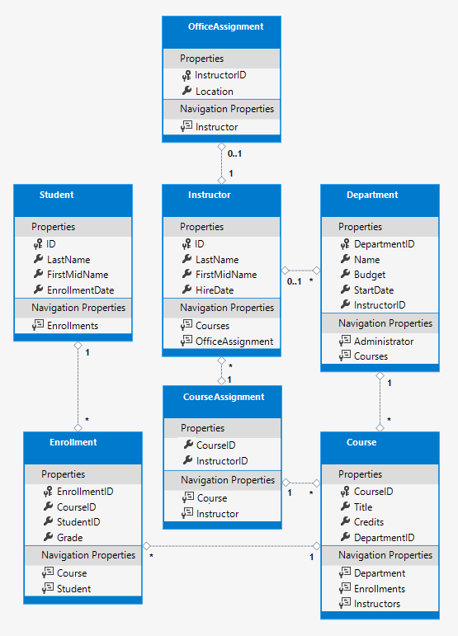
Navigation properties
Provide access to relational data
When is the relational data loaded (via SQL)?

Slide 16
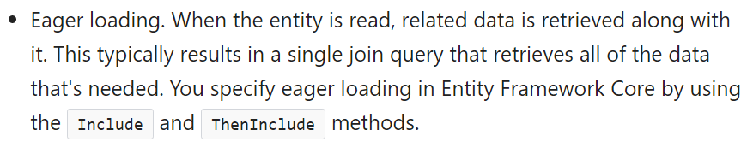
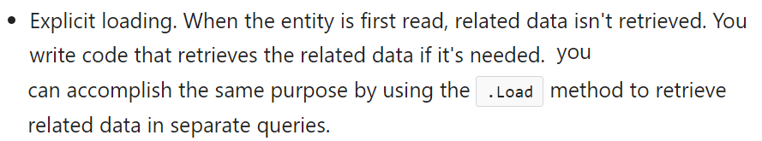
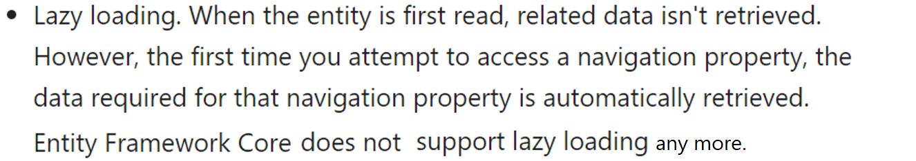
Reading Relational data

Slide 17
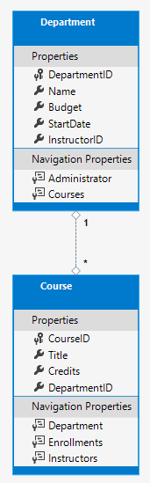
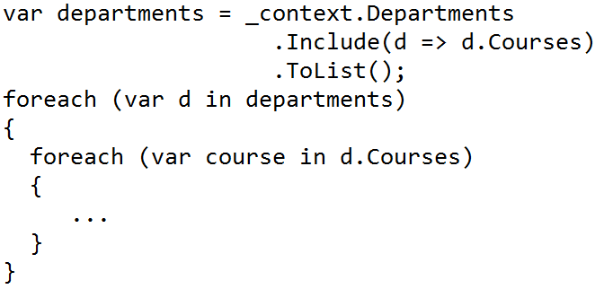
Eager Loading
SQL to DB?
1 join with both the departments and the courses per department

Slide 18
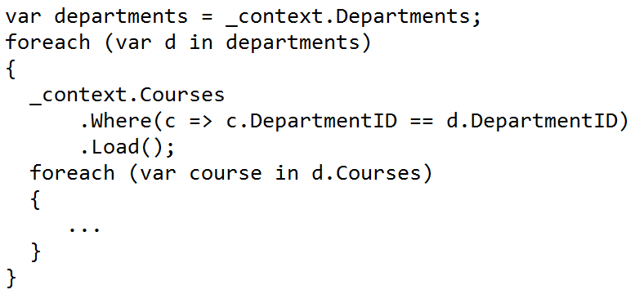
Explicit loading
sql to DB?
1 select for the departments + for every department 1 select for the courses of that department

Slide 19
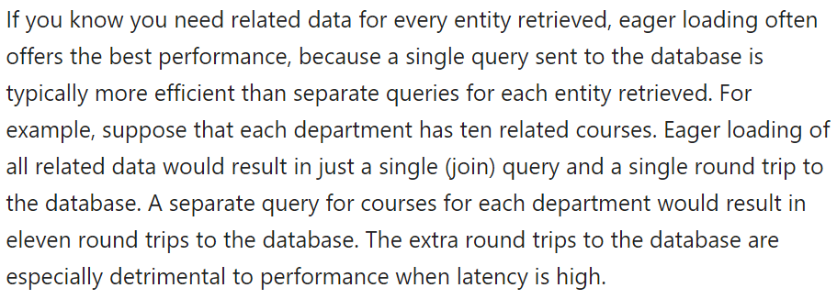
Performance considerations

Slide 20
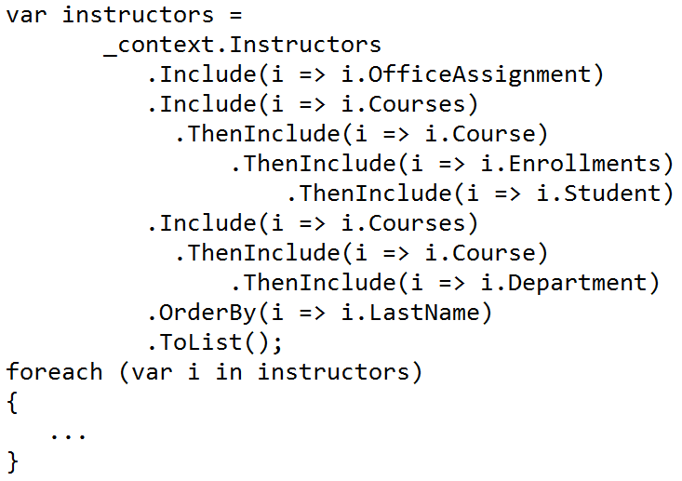
Eager Loading (exercise)

Slide 21
Exercise
MotoGP Part 5

